Slide 1
Bombster
Piotr, Dariusz, Wen, Robert

Slide 2
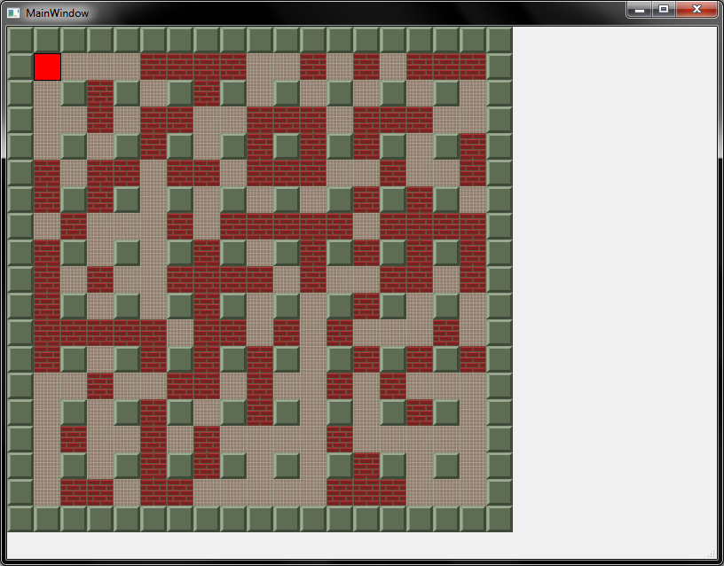
Previous State

Slide 3
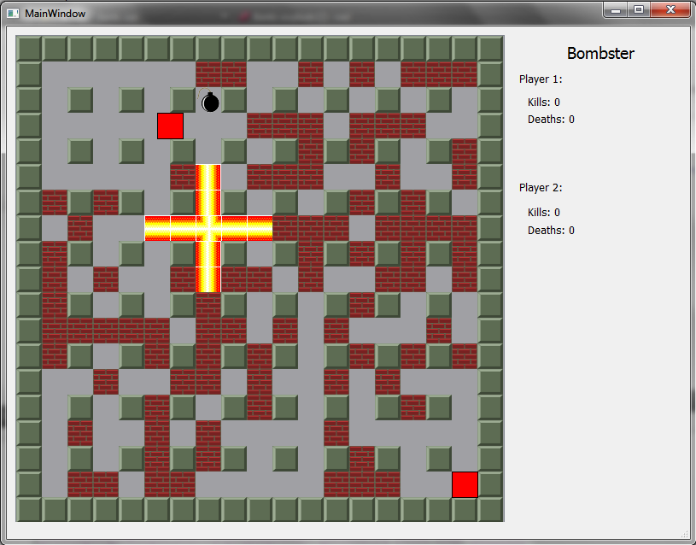
Current State

Slide 4
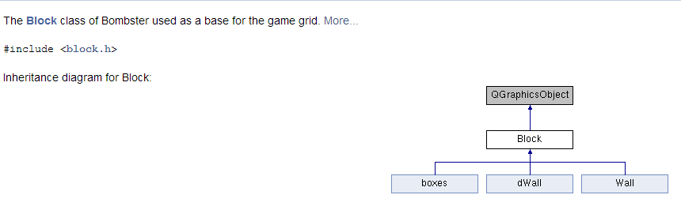
Now Fully Documented!
Doxygen Documentation
An example of the documentation for the Block class

Slide 5
What Works and What Doesn’t
Working
- Movement
- Collision Detection
- Bombs
- Explosions
- Music/Sound Effects
Not Working
- Player 2

Slide 6


Some Extra Changes Not Yet Implemented
Character Images
Player 1
Player 2
Making art cohesive

Slide 7
Demo Time!

Slide 8
Questions/Suggestions?
?

